Slide 1
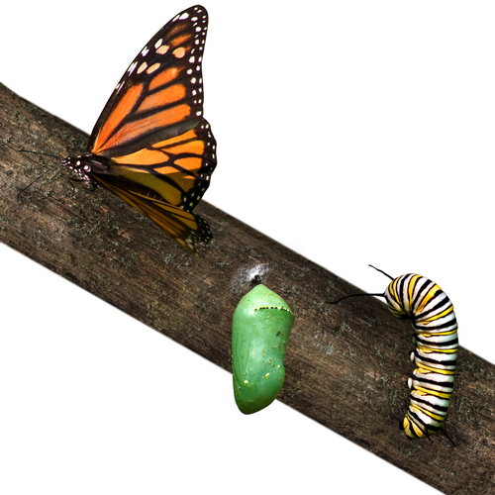

Transform with In Good Company
Would you like long lasting motivation, commitment and high performance?
Are there dysfunctions within your team that you’d like to fix?
Would you like to increase the self awareness, potential and talent of your management teams?
Would you like a development program that ensures team members impact on the bottom line?
We know that you can’t change the performance and culture of your team in a day that’s why we have created Transform, a long term development programme that blends development days with individual coaching. We work intensively with your team over a period of 12 months to ensure that change is embedded so at the end of the programme the team has what it takes to sustain high performance.
Who is Transform for?
Newly formed teams
Teams that have obstacles getting in the way of high performance
Teams looking to increase their performance for the long term
What will Transform do for me?
Transform delivers the following:
High performing, highly motivated and committed teams that deliver outstanding business results
The elimination of any dysfunctions getting in the way of high performance
An environment which fosters collaborative, high trust relationships
Clear expectations and accountabilities
New ways of working that foster effective relationships
Positive communication and behaviours conducive to high performing teams
Alignment of personal values and team culture to ensure commitment, passion and engagement
A winning mindset within the team
A strong identity to the company, the team and the employees role within it.
What will I get for my investment?
Pre course preparation, support and diagnostics
12 days of highly facilitated, interactive workshops with experienced facilitators, trainer and coaches
On the job coaching for all team members to apply techniques, skills and behaviours
Additional interventions as necessary to eliminate team dysfunctions (i.e. Mediation, employment advice)
End of programme review
What is the Investment?
Prices for Transform start at £3500 per head.
The programme can be tailored to an organisations need, enquire now for an accurate quotation.
Contact Us Now on info@igcompany.co.uk
07727679994
07869131938

